Slide 1

LIBERTY INVESTMENTS
Mortgage Calculator Application
CSC205
Kyung Haug
CEO | CFO | Lead, and only.., Software Engineer | Intern for coffee

Slide 2


Our New Application
The finance department has been requesting an internal tool to easily calculate a client’s potential mortgage rate using our institution’s rates.
Today, our developers produced a desktop window’s form application to be rolled out to test the application and its usage

Slide 3
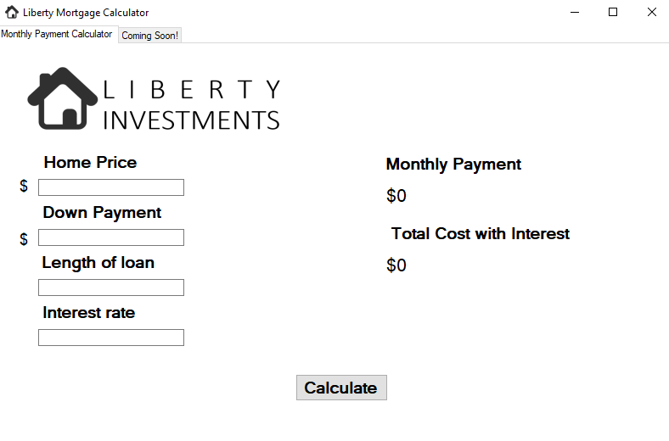
Our New Application
This beta application is simple, but easy to use and allows new features to be easily added.
Built using Visual Studio and C#

Slide 4
Application Demo
As seen in this demo, you can quickly type in general info about a property to generate a monthly payment estimate and share the total cost it may be with interest.

Slide 5
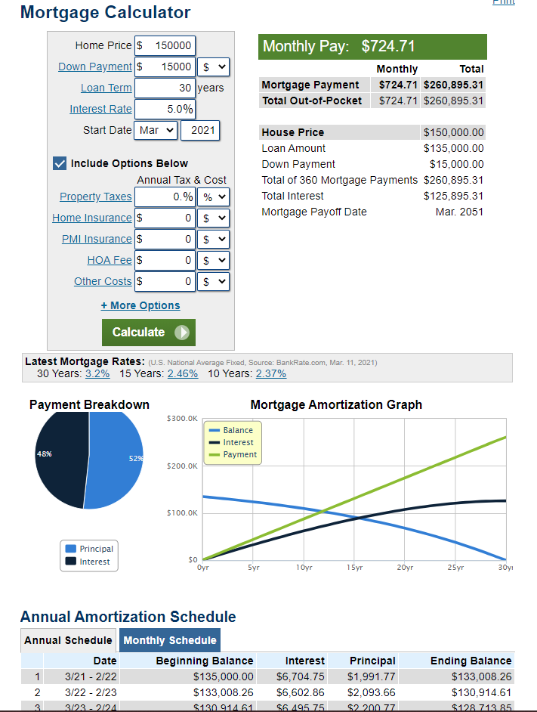
Inspiration
Provide details that go beyond a typical calculator to ensure smart money choices

Slide 6
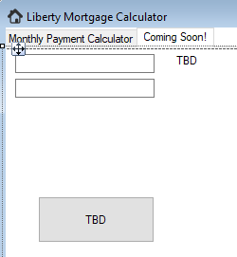
Future Plans
Phase 1
Establish connection to online rates
Phase 2
Add car loan calculator
Add MS Excel/Access/dbo export feature

Slide 7
LIBERTY INVESTMENTS
Thank you!
We hope you enjoy the rollout and leave feedback on our company’s website!

